Slide 1
STAT 5940: Tutorial 2
Seth Beckett

Slide 2
CONTENTS
Introduction
Process
Roadblocks
Conclusion

Slide 3
INTRODUCTION
At Discover Financial Services, I work on the Enterprise Data Stewardship team. We are in charge of helping ensure compliance throughout the enterprise by training and accounting for data stewards, or those who are responsible for the production and consumption of data.

Slide 4
Excel sheet update automation
Leveraging the use of Python to automate a process of manual excel updates, saving DFS 50+ hours per year!

Slide 5
Process
Create Imitation Data
Automating Change Detection
Creating & Formatting Output

Slide 6
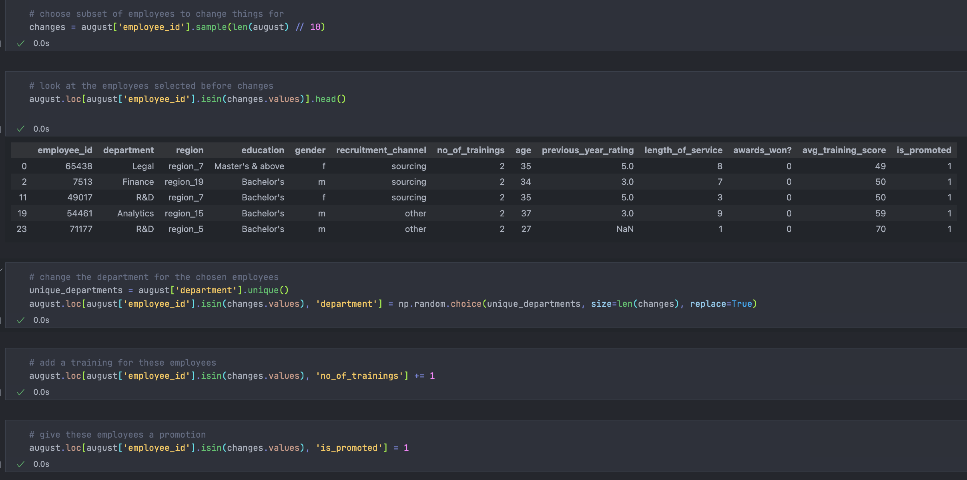
Process: Creating Imitation data
Discover is extremely secure and strict about using and copying code and/or company data, so I first had to create dummy data that was similar to what I used
Steps:
Read in two of the months of simulation data created in tutorial 1
Create changes in the August month that differentiate it from the July Dataset
Resave the CSV’s to use later

Slide 7
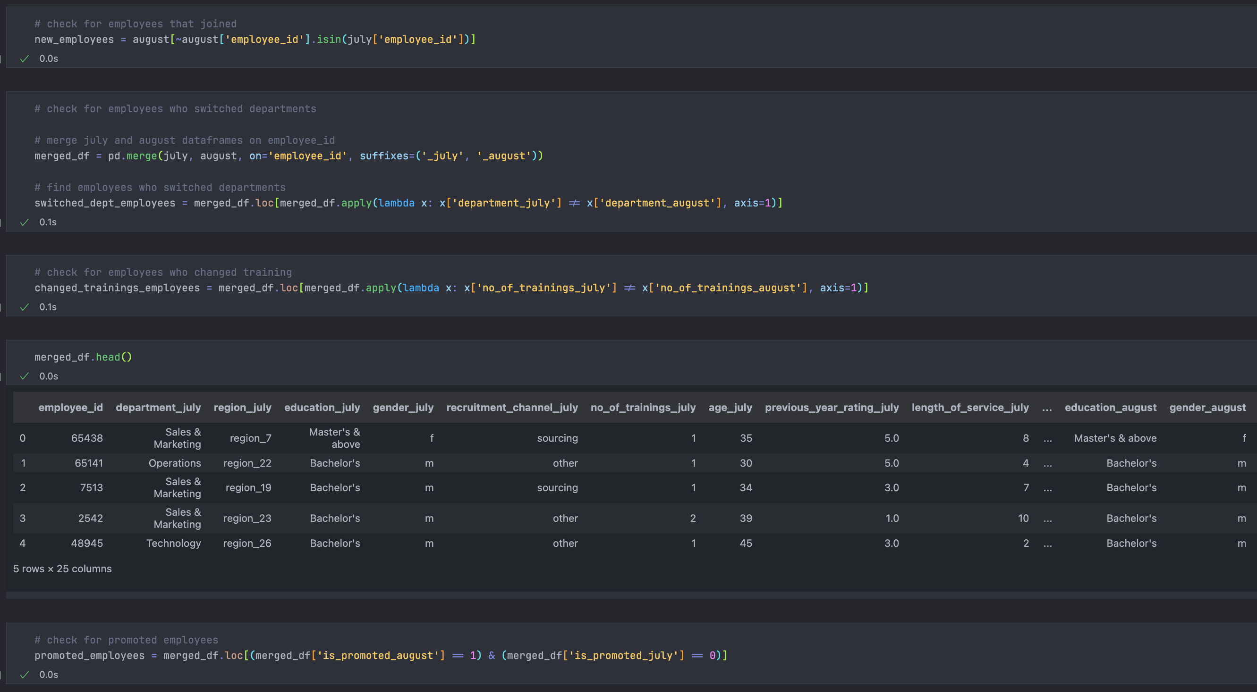
Process: Automate Change Detection
HR data changes from month to month, and previously these changes were manually checked
Using Python, we are able to manually check for specific changes that we want to track
We then store each change in a separate dataframe

Slide 8
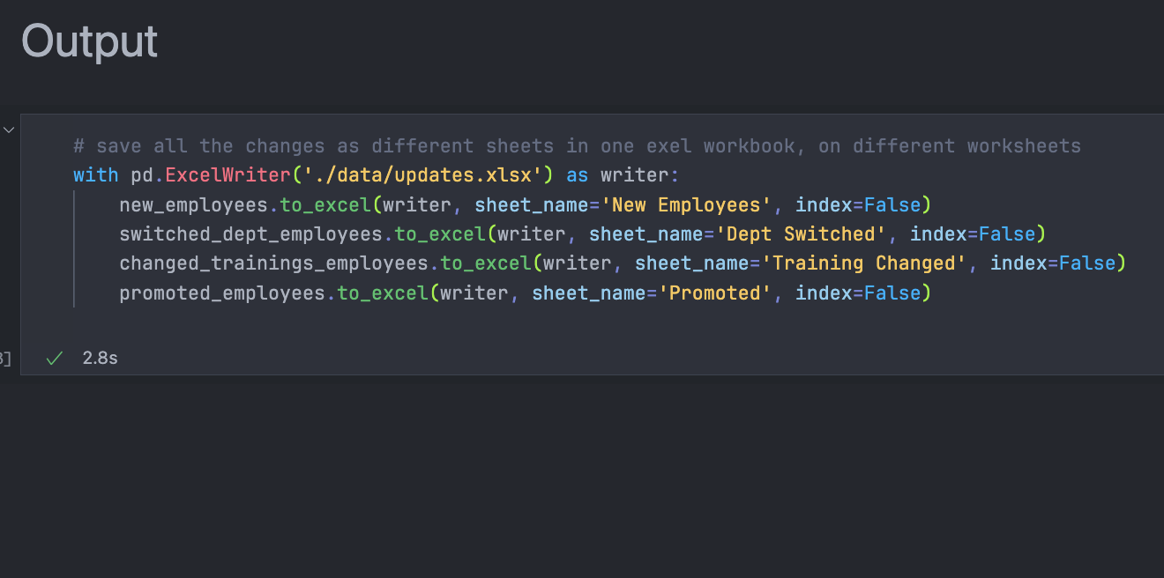
Process: Creating and formatting output
Finally, we can output the data for manual review (to confirm data integrity)
In this step we use each of our dataframes representing a change we’re looking for to create a worksheet
These worksheets are a part of the same workbook, which contains all of the changes as separate tabs

Slide 9
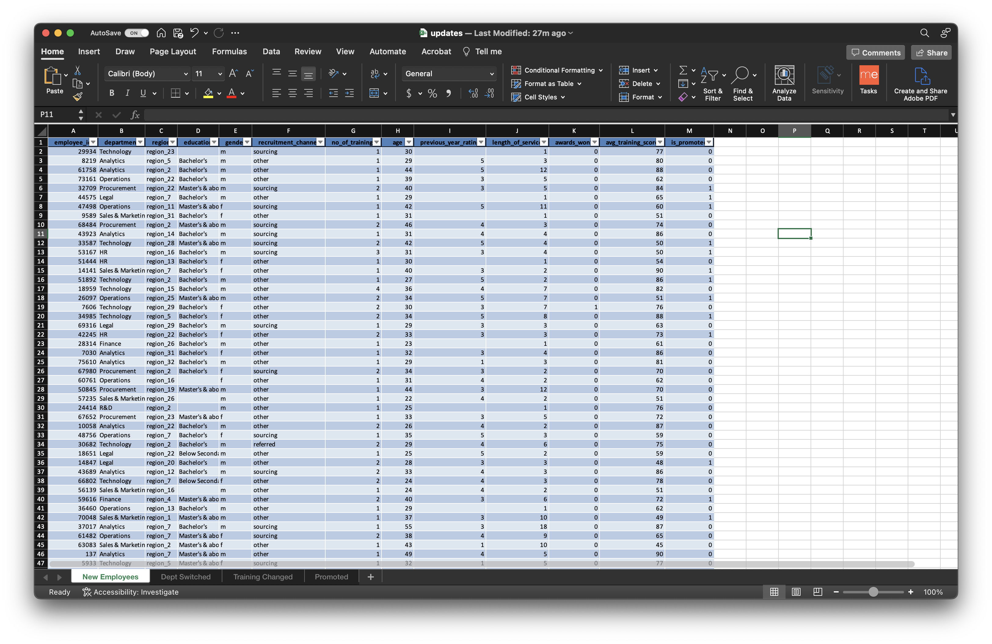
Output

Slide 10
Roadblocks
Technical
Other
Checking for changes, I ran into several issues with the logic behind it. Sometimes we would get data that changed format between months, which would cause difficulties in creating generalizable code
Team is nontechnical, so any changes I made or code I created had to be meticulously documented
Balancing this project with other projects and responsibilities
Accessing protected data as a new employee proved to be a tedious experience, as DFS is a very secure company

Slide 11
Conclusion
By creating this Python process for tracking and checking for updates of data between months, I was able to save my company 50+ hours of manually searching and verifying data per year. This process ensures a consistent and verifiable data checking process.

Slide 12

Appendix
Link to Github
https://github.com/sethbeckett/stat5940-tutorial1

